Slide 1
AIML- Project
Calories Burnt Prediction
Team Members
Heena 2210990398
Himani 2210990401
Himanshi 2210990403

Slide 2
CONTENT
Problem Statement
Objective
Tools Used
Data Summary
Exploratory Data Analysis
Challenges
Recommendations
Conclusions

Slide 3
PROBLEM STATEMENT
Despite the growing interest in fitness and health monitoring, accurately estimating calories burnt during physical activities remains a challenge. Existing methods often lack precision due to individual variability and the complex interplay of factors such as activity type, intensity, and biometrics.
Our project aims to address this challenge by developing a machine learning model capable of predicting calorie expenditure with high accuracy. By leveraging diverse datasets and advanced algorithms, we seek to overcome the limitations of traditional approaches and provide users with a reliable tool for tracking their fitness progress and making informed decisions about their health goals.

Slide 4
OBJECTIVE
The primary objective of this project is To develop a machine learning model capable of accurately predicting calorie expenditure during physical activities, considering factors such as activity type, duration, intensity, and user biometrics.

Slide 5
Tools Used
Google Colab is used as IDE.
Pandas and NumPy are used for Data Manipulation & Pre-processing and Mathematical functions respectively.
For visualization of the plots, Matplotlib, Seaborn, Plotty are used.
XGBoost Regressor is used for supervised regression tasks.
Scikit-learn is used for implementing machine learning algorithms and model evaluation.

Slide 6
Data Summary
Here's an example of how the data summary might look for each data type:
Categorical Data:
1.User_ID: Categorical variable representing the unique identifier for each user.
2.Gender: Categorical variable indicating the gender of the user.
2.Numerical data
1.Age: Numeric variable representing the age of the user.
2.Height: Numeric variable representing the height of the user.
3.Weight: Numeric variable representing the weight of the user.
4.Duration: Numeric variable representing the duration of physical activity in minutes.
5.Heart_Rate: Numeric variable representing the heart rate during the activity.
6.Body_Temp: Numeric variable representing the body temperature during the activity.
7.Calories: Numeric variable representing the number of calories burnt during the activity.

Slide 7
FEATURES DESCRIPTION
User_ID: A unique identifier for each user. This categorical feature helps differentiate between individual users in the dataset.
Gender: Categorical feature indicating the gender of the user. It helps categorize users into male or female groups.
Age: Numerical feature representing the age of the user in years. Age can influence factors such as metabolism and fitness levels.
Height: Numerical feature representing the height of the user in centimeters. Height is an important biometric factor that can affect calorie expenditure during physical activities.

Slide 8
5.Weight: Numerical feature representing the weight of the user in kilograms. Weight is another crucial biometric factor influencing calorie expenditure.
6.Duration: Numerical feature representing the duration of physical activity in minutes. This feature indicates how long each activity session lasted.
7.Heart_Rate: Numerical feature representing the heart rate of the user during the activity. Heart rate provides insights into the intensity of the activity.
8.Body_Temp: Numerical feature representing the body temperature of the user during the activity. Body temperature can vary depending on factors such as intensity and duration of the activity.
9.Calories: The target variable, representing the number of calories burnt during the activity. This numerical feature is what we aim to predict based on the other features in the dataset.

Slide 9
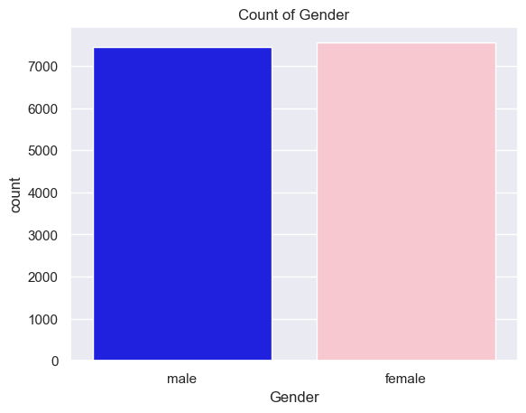
Gender Count
Here you can see, the data marked in the blue color represents male data points and pink color represents female data points.
The important thing that we are getting here is the data point is almost similar.
we have equal distribuiton of male data points and female data points.

Slide 10
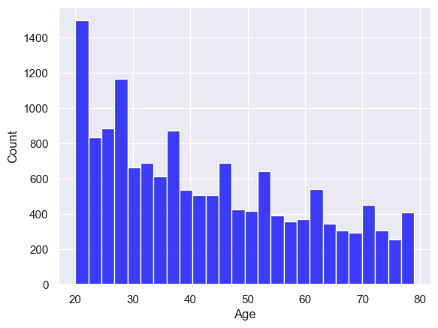
Distribution of Age
Here, the X axis represents the age of the person in the dataset and count means how much data is present for that particular age.
so, you can see here we have more values in the range of 20 and 30 . the value is decreasing with the increase in age.

Slide 11
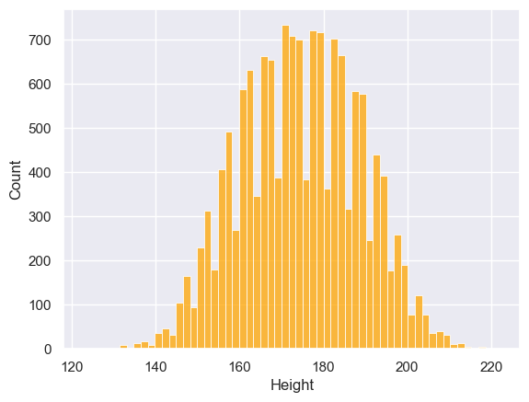
Distribution of Height
Here, the X axis represents the height of the person and Y axis represents count.
so, you can see more people are present in the height of 160 and 180.

Slide 12
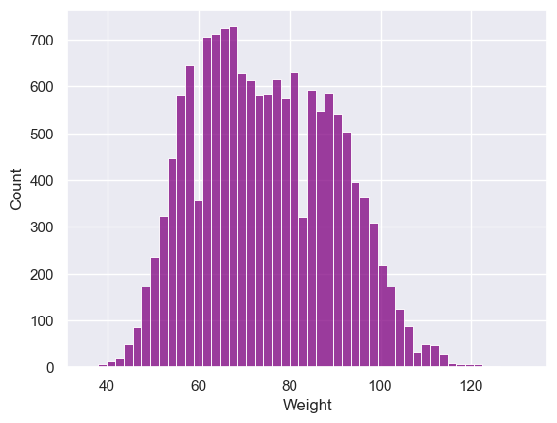
Distribution of Weight
Here, the X axis represents the weight of the people and Y axis represents count.
so, you can see more people in the weight of around 60.

Slide 13
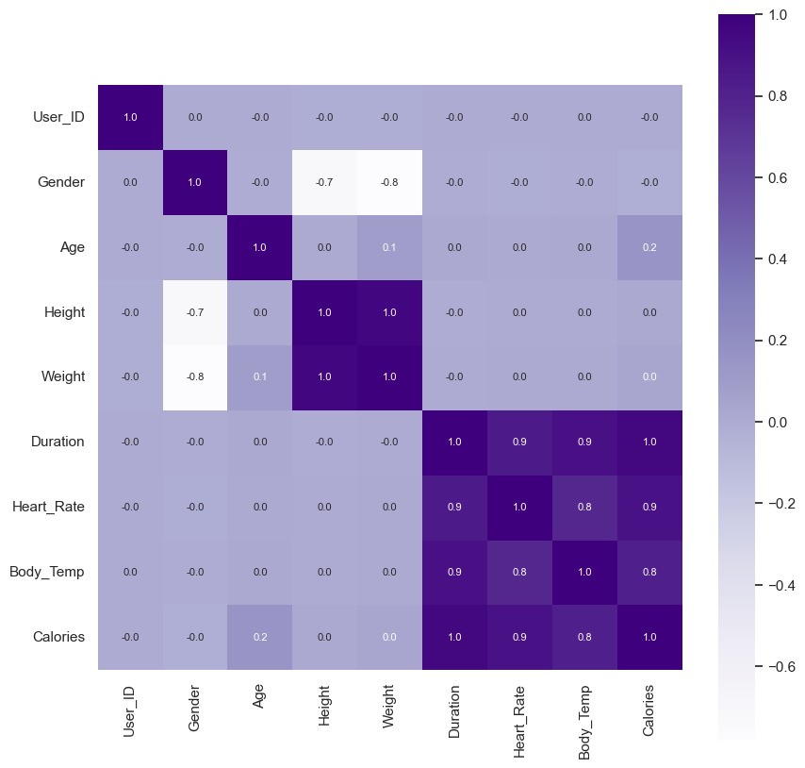
Heatmap to understand the correlation
Here, Each square represents the connection between two variables. The color of each square tells you how strong the relationship is: darker colors mean a stronger connection, while lighter colors mean a weaker one. The numbers inside the squares give you the exact strength of the connection.

Slide 14
Challenges
Data Quality: Ensuring the dataset is clean, accurate, and representative of the target population is crucial. Challenges may include dealing with missing values, outliers, and inconsistencies in the data.
Inter-Participant Variability: Individuals vary significantly in terms of metabolism, fitness levels, and physiological characteristics. Accounting for this variability in the model and ensuring it can generalize well to unseen individuals is a challenge.
Nonlinear Relationships: The relationship between activity features (such as duration, intensity) and calorie expenditure may be nonlinear and complex. Capturing these relationships effectively requires advanced modeling techniques and feature engineering.

Slide 15
Recommendations
Data Quality: Ensure data is diverse, clean, and validated.
Feature Engineering: Incorporate relevant features and transformations.
Model Selection: Experiment with various algorithms, balancing complexity and interpretability.
Account for Variability: Personalize models and strategies for individual differences.
Nonlinear Relationships: Explore nonlinear modeling techniques and feature selection.
Evaluation: Use appropriate metrics and validate model performance.
User Engagement: Design user-friendly interfaces with personalized recommendations.

Slide 16
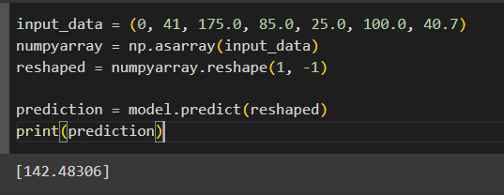
result
Here after taking the input of different features that we have included in the project ,
it predicts the calories burnt according to them with a minute error which shows the
Accuracy of the project.

Slide 17
Conclusion
In conclusion, building an accurate predictive model for estimating calorie expenditure during physical activities requires prioritizing data quality, feature engineering, and model selection. Accounting for individual variability and nonlinear relationships enhances model effectiveness. Thorough evaluation and user engagement are crucial for practical utility and adoption. By integrating these recommendations, we can create a valuable tool for health and fitness monitoring.

Slide 18
Thank
you

